Slide 1
Meditation Attendance System
Kabinad Melaku
Andualem Hailu
mIChael Berhanu
Kassahun

Slide 2


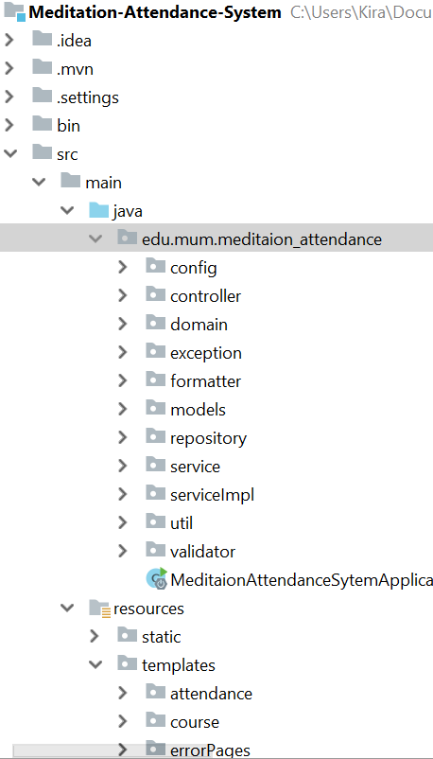



Project Structure: Spring Boot monolith Thymeleaf

Slide 3
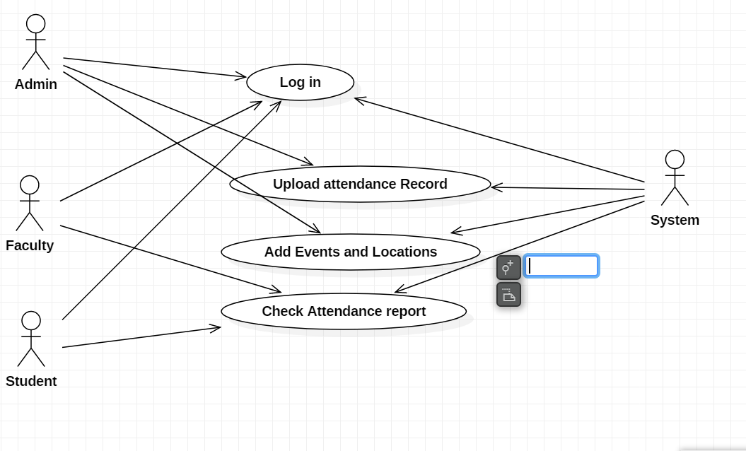
Use Case Diagram

Slide 4
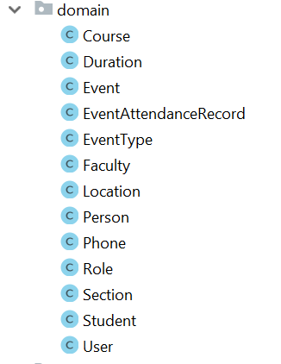
Domains

Slide 5
Demo
Process attendance data ( 2 formats)
Faculty morning meditation report per block
Student view attendance info (accumulative and block)
Generate Attendance report by entry
Login/Logout
Authorization (method level and URL level)

